Slide 1

APPM: Introduction to HPC

Slide 2
CURC Alpine: New User Seminar
Instructor: Trevor Hall
Website: www.rc.colorado.edu
Helpdesk: rc-help@colorado.edu
Slides: https://github.com/ResearchComputing/APPM_HPC
Survey: http://tinyurl.com/curc-survey18

Slide 3
Learning Goals
Part 1: Overview
Overview of CU Research Computing (CURC) and our resources
Part 2: Using Blanca
Using Blanca
Logging in
Basic Linux Commands
File editing
Linux filesystem
Software modules on Blanca
Bash scripts and job scheduling

Slide 4
Part 1 - Overview

Slide 5
What is Research Computing?
Provide services for researchers that include:
High performance computing (HPC)
Data visualization
Data storage
High speed data transfer
Data management support
Consulting
Training
We are likely best known for:
Alpine Supercomputer (~22,000 cores)
Blanca ”condo” cluster (~4,000 cores)
PetaLibrary storage
Notes:
Can advise on Secure Research, have a CMMC environment (Preserve) available (let know available if doing DoD or DoE things)

Slide 6

Primarily known for:
High Performance Computing (HPC)

Slide 7
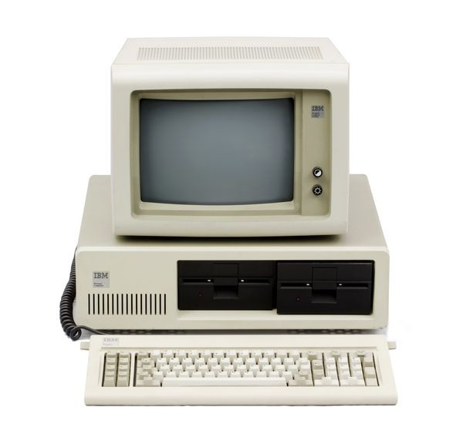
High Performance Computing (HPC)
vs. Traditional Computing
Traditional computing generally has access to a single processor (perhaps multiple cores)

Slide 8
What can I use HPC for?
Solving large problems that require more:
Memory than you have on your PC
cores/nodes/power thank you have on your PC
Jobs that require hardware you may not have:
High Performance GPU computing
Specific Operating System
Visualization rendering

Slide 9
What can I use HPC for?
Jobs that would take a long time on local machines can instead be distributed over hardware:
Parallelized to split up then joined (if software enabled)
Broken up into many serial jobs
BIG Job
Results
Tiny Job
Tiny Job
Results
Tiny Job

Slide 10
Research Computing Resources

Slide 11
HPC Cluster: Alpine
Alpine is the 3rd-generation HPC cluster at CURC, following:
Janus
RMACC Summit
Alpine is a heterogeneous cluster with hardware currently provided by CU Boulder, CSU, and Anschutz
Access available to CU Boulder, CSU, AMC and RMACC users
Alpine

Slide 12
HPC Cluster: Alpine
Hardware on Alpine will continue to be purchased and released in stages:
Alpine (stage 4):
256 General CPU Nodes
AMD Milan, 64 Core, 3.74G RAM/Core
12 NVIDIA GPU Nodes
3x NVIDIA A100 (atop General CPU node)
8 AMD GPU Nodes
3x AMD MI100 (atop General CPU node)
22 AMD High-Memory Nodes
AMD Milan, 48 Core, 21.5G RAM/Core
Additional Hardware contributed by CSU, AMC
Nodes which boost priority for CSU/AMC users
Alpine
Notes:
AMC – must sign end user agreement

Slide 13
HPC Cluster: Alpine
Interconnect
CPU nodes: HDR-100 InfiniBand (200Gb inter-node fabric)
GPU nodes: 2x25 Gb Ethernet +RoCE
Scratch Storage: 25Gb Ethernet +RoCE
Operating System
RedHat Enterprise Linux version 8 operating system
Alpine

Slide 14
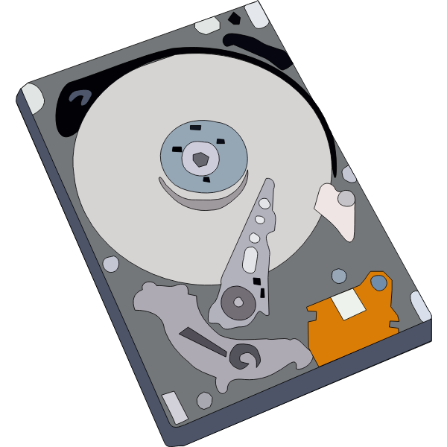

Storage at CURC
PetaLibrary
Local or Cloud
Core
Included with RC account
/home
/projects
scratch space
You can download your data locally or to a variety of other cloud resources
Cloud Foundations at Research Computing
Paid Service for:
Storage
Archive
Sharing of research data
Notes:
CU Research Computing hosts a free-to-use on-premise cloud service, called CUmulus, which supports cases not well-suited for HPC such as webservers, databases, and long-running services. The CUmulus service includes access to a Virtual Private Cloud (VPC) which provides users with a logically isolated section of the cloud with a small number of outside routable floating IP addresses. Within this VPC customers will be given an allocation of:
CPU cores
Memory
Storage

Slide 15

Data Sharing: Within RC
Sharing workspaces
Project space
Scratch Space
PetaLibrary Space*
*If you have purchased PetaLibrary space
Notes:
Highlight not sharing home space
Where configs are at, people can mess with them

Slide 16
Data Sharing: Outside RC
Globus (recommended):
GUI Web Application
Automates large transfers
Resumes failed transfers
Distributes large transfers across DTNs
Endpoints that can shared
Data Transfer Nodes (DTN)
Internal CU network needed (VPN)
Command line tools
scp, sftp, rsync, rclone

Slide 17

Cloud Computing
CURC supports both AWS and on-premise cloud via CUmulus
For use cases not well-supported by HPC
Can be used as an alternative to HPC
Can be used to enhance HPC
Automatic job submission, high availability, etc.
Request a CUmulus application by contacting the RC helpdesk at rc-help@colorado.edu
Notes:
Cloudbursting

Slide 18
Blanca
A “condo” cluster whereby individual research groups own nodes
List of nodes and groups can be found here
Users have dedicated access to their group’s nodes (e.g., blanca-appm)
Jobs up to 7 days long
Can also run ‘preemptable’ jobs on other groups nodes (jobs up to 24 hours long)
More documentation on Blanca: https://curc.readthedocs.io/en/latest/access/blanca.html
Notes:
Highlight not sharing home space
Where configs are at, people can mess with them

Slide 19
blanca-appm
bnode0501, bnode0502 (2 nodes)
32 (effectively 64) cores, avx2, Cascade, 2.3 GB RAM/core)
bnode0508, bnode0509 (2 nodes)
40 (effectively 80) cores, avx2, Cascade, 2.3 GB RAM/core)
Notes:
Highlight not sharing home space
Where configs are at, people can mess with them

Slide 20
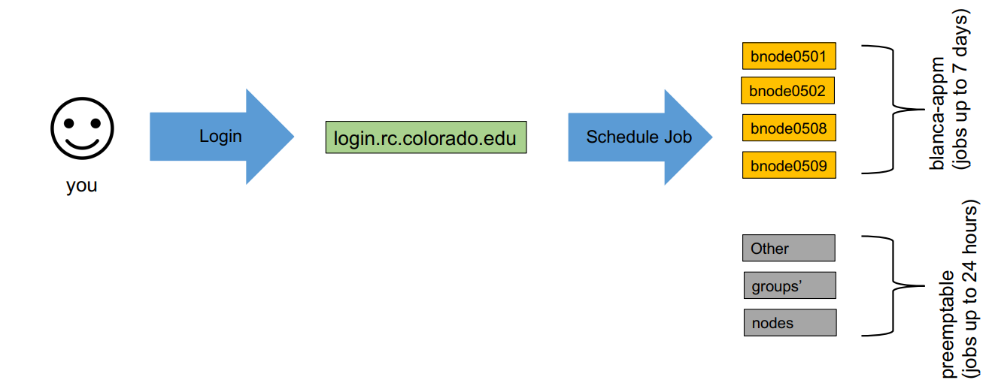
Accessing Research Computing

Slide 21
How to Access RC Resources?
Get an RC account
Set up two-factor authentication with Duo
(Inform us of any specific needs)
Log in
Create greatness! (responsibly)

Slide 22
Getting an RC Account
University of Colorado, Boulder users and affiliates:
Request an account through the RC Account request portal
https://rcamp.rc.colorado.edu/accounts/account-request/create/organization

Slide 23
Your RC Account
Access to:
Alpine Cluster
Core Storage
PetaLibrary Storage*
Open OnDemand
Approximately 2,000 Service Units (SUs) per month
*If purchased
Notes:
https://ondemand.rc.colorado.edu/
https://ondemand-rmacc.rc.colorado.edu/

Slide 24
Your RC Account
How can I use more computational time?:
Trailhead Allocation (Default)
~2,000 SUs / Month
Ascent Allocation
350,000 SUs
Peak Allocation
>350,000 SUs
Request an allocation at https://curc.readthedocs.io/en/latest/clusters/alpine/allocations.html?highlight=alpine%20allocation#comparing-trailhead-auto-allocation-ascent-allocation-and-peak-allocation-tiers

Slide 25
Your RC Account
How much storage do I have available?:
/home directory
2GB
/projects directory
250GB
/scratch and /rc_scratch
10TB*
More documentation at: https://curc.readthedocs.io/en/latest/compute/filesystems.html

Slide 26
Logging In
It’s important to note that you are NOT logging into any specific resource, Alpine, Blanca, etc.
When you log in, you land on our login nodes
From there, you can access our other resources:
Alpine
Blanca
Petalibrary

Slide 27
Part 2 (Using Blanca)

Slide 28
Logging into CURC
ssh <identikey>@login.rc.colorado.edu
Enter your identikey password
Authenticate by accepting the Duo push to your smartphone
- Can also authenticate by text message, phone call, or token
More info here: https://curc.readthedocs.io/en/latest/access/logging-in.html

Slide 29

What is Linux?
Part of the Unix-like family of operating systems.
Started in early ‘90s by Linus Torvalds.
Typically refers only to the kernel with software from the GNU project and elsewhere layered on top to form a complete OS. Most is open source.
Software
Software
Software
Software
OS Kernel
Hardware
images courtesy of wikicommons
Notes:
The Linux kernel is the main component of a Linux operating system (OS) and is the core interface between a computer’s hardware and its processes. It communicates between the 2, managing resources as efficiently as possible.

Slide 30
Why Use Linux?
Default operating system on virtually all HPC systems and the foundation for many business services globally
Extremely flexible
Fast and powerful
Many tools for software development
You can get started with a few basic commands and build from there
Notes:
Add that Linux is open source

Slide 31
Anatomy of a Linux command
command [flags] [target(s)]
ls –l myworkdir/
Case is important!
Help on commands is available through the “man” command (short for manual)
man ls
Notes:
-l : Displays the mode, number of links, owner, group, size (in bytes), and time of last modification for each file
-L: Lists the file or directory contents that the link references. This is the default action.

Slide 32
File and Directory related commands
pwd– prints full path to current directory
cd – changes directory; can use full or relative path as target
mkdir – creates a subdirectory in the current directory
rmdir – removes an empty directory
rm – removes a file (rm -r removes a directory and all of its contents)
cp – copies a file
mv – moves (or renames) a file or directory
ls – lists the contents of a directory (ls -l gives detailed listing)

Slide 33
File-viewing commands
less– displays a file one screen at a time
cat – prints entire file to the screen
head – prints the first few lines of a file
tail – prints the last few lines of a file (with -f shows in realtime the end of a file that may be changing)
diff – shows differences between two files
grep – prints lines containing a string or other regular expression ps –df | grep xx
sort – sorts lines in a file
find – searches for files that meet specified criteria
wc – count words, lines, or characters in a file
Notes:
ps lists current running processes
Pipes: | sends output of one command to another command

Slide 34
The Linux Filesystem
System of arranging files on disk
Consists of directories (folders) that can contain files or directories
Levels in full paths separated by forward slashes:
e.g. /home/user/scripts/analyze_data.sh
Case-sensitive; spaces in names discouraged
Some shorthand:
. (the current directory)
.. (the directory one level above)
~ (home directory)
- (previous directory, when used with cd)

Slide 35





























Multiple Users
Filesystem
/
bin
usr
home
/local
/<username>
Relative path
../../usr/local
/bin
/documents
/hpc
/usr/local/bin
Absolute path
/notes.txt
/home/<username>/documents/hpc/notes.txt

Slide 36
Jobs
What is a “job”?
Work for the cluster to perform on
Has a unique ID
Batch jobs
Submit job script which will be executed when resources are available
Create script containing information about the job
Submit the job file to a queue
Interactive jobs
Work interactively at the command line of a compute node

Slide 37
Job Scheduling
CURC Clusters are shared resources, jobs are:
Submitted to a queue
When the required resources become available, the scheduler determines which set of nodes to use
Executes your job
Computer
Hardware
Submit Job
Management
service
Get Results
Storage

Slide 38
Job Script: 3 main parts
Directives
Specify resource requirements
Software
Because jobs run on a different node than from where you submitted…
…software that is needed must be loaded via the job script
User scripting
the actual user scripting that will execute when the job runs
#!/bin/bash
## Directives
#SBATCH --<resource>=<amount>
## Software
module purge
## User Scripting
hostname # example bash command

Slide 39
Slurm Options (directives)
#SBATCH <options> sbatch <options>
Allocation: --account=<account_no>
Partition: --partition=<partition_name>
Sending emails: --mail-type=<type>
Output file: --output=<file name> (%j gives you job id)
Number of nodes: --nodes=<nodes>
Number of tasks: --ntasks=<processes>
Quality of service: --qos=<qos>
Reservation: --reservation=<name>
Wall time: --time=<wall time>
Job Name: --job-name=<jobname> ...etc...
FYI: You do NOT actually type <> above – this designates something specific you as a user must enter about your job

Slide 40
Software and Jobs
Okay so running a job is easy, but how do I run a job with my software?
LMOD
Module system on CURC systems
Modifies your environment to make your desired software visible to your terminal.
$ module load matlab
$ ml matlab #shorthand version!

Slide 41
Software and Jobs
More LMOD commands:
What if my software isn't available through LMOD?
Software must be installed locally if not available through LMOD
RC User support is happy to assist,installs are best effort
For more assistance contact rc-help@colorado.edu
$ module purge #Unloads all current modules
$ module unload python #Unloads python
$ module spider python #Searches for python in module tree

Slide 42
Topics we didn’t cover today
Job arrays (when you need to run lots of similar tasks)
Running preemptable jobs
CURC OnDemand (Interactive interface https://ondemand.rc.colorado.edu )
Use of conda on CURC
..and lots of other cool stuff
See: https://curc.readthedocs.io ; or email rc-help@colorado.edu to schedule a consultation

Slide 43
Help! I’m stuck, where do I go?
Documentation: curc.readthedocs.io/
Trainings with Center for Research Data and Digital Scholarship (CRDDS): https://www.colorado.edu/crdds/
Coming up:
RC Quick Byte – Getting an Account (1/23)
Alpine New User Seminar (1/25)
Supercomputing Spin Up Part 1 – Working with Linux (1/30)
Supercomputing Spin Up Part 2 – Job Submission (2/1)
Helpdesk: rc-help@colorado.edu
Consult Hours (Tuesday 12:00-1:00, Thursday 1:00-2:00)

Slide 44
Questions?
CURC User Policies: https://curc.readthedocs.io/en/latest/additional-resources/policies.html?highlight=policies#curc-user-policies

Slide 45
Survey and feedback
http://tinyurl.com/curc-survey18

